Slide 1
Design for Verification Project Update
2021-04-11
Eldrick Millares, Jack Humphries (eldrick, jhumphri@stanford.edu)

Slide 2
Recap:
Ongoing Deployment on Steel (simple design)
Ongoing Deployment on BOOM (complex design)
Developing SQED Debug Utilities

Slide 3
Steel Demo - Current Status
Fixed SIF Commit Issue
Added edge detector circuit
Properly implements C2 constraint
CSR causing false counterexamples in testing
Main Idea: CSR Register is not duplicated. Causes QED inconsistency
Specific Example: Initial CSR state causes trap to be taken

Slide 4
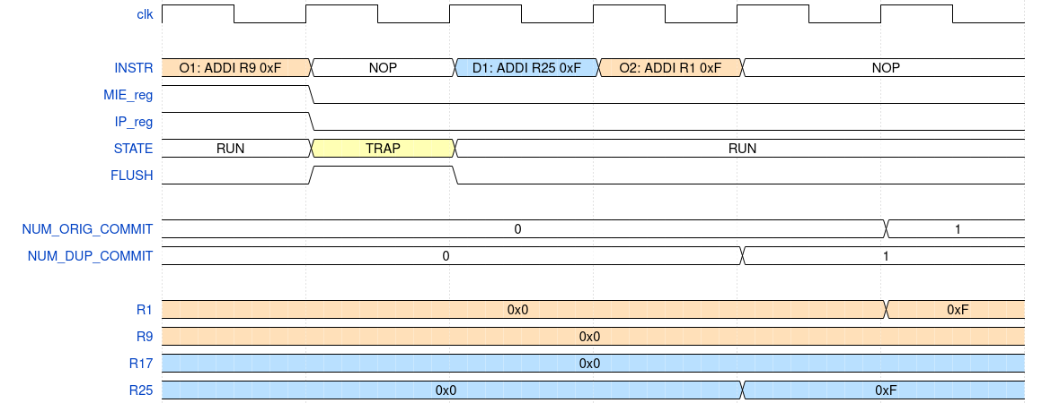
Initial state of CSR set to trap at T0
Trap taken in T1, pipeline is flushed, current instruction invalidated to NOP
Original Instruction O1 does not commit in T2 due to flush
Duplicate Instruction D1 does commit in T4 since flush is not duplicated
Original Instruction O2 commits in T5
# of Original == # of Duplicate Instruction, QED Inconsistent at T5
T0
T1
T2
T3
T4
T5
Notes:
{signal: [
{name: 'clk', wave: 'p.....'},
{},
{name: 'INSTR', wave: '42542.', data: ['O1: ADDI R9 0xF', 'NOP', 'D1: ADDI R25 0xF', 'O2: ADDI R1 0xF', 'NOP'], },
{name: 'MIE_reg', wave: '10....'},
{name: 'IP_reg', wave: '10....'},
{name: 'STATE', wave: '232...', data: ['RUN', 'TRAP', 'RUN']},
{name: 'FLUSH', wave: '010...'},
{},
{name: 'NUM_ORIG_COMMIT', wave: '2....2', data: ['0', '1']},
{name: 'NUM_DUP_COMMIT', wave: '2...2.', data: ['0', '1']},
{},
{name: 'R1', wave: '4....4', data: ['0x0', '0xF']},
{name: 'R9', wave: '4.....', data: ['0x0', '0xF']},
{name: 'R17', wave: '5.....', data: ['0x0', '0xF']},
{name: 'R25', wave: '5...5.', data: ['0x0', '0xF']},
], config: { hscale: 4 }}

Slide 5
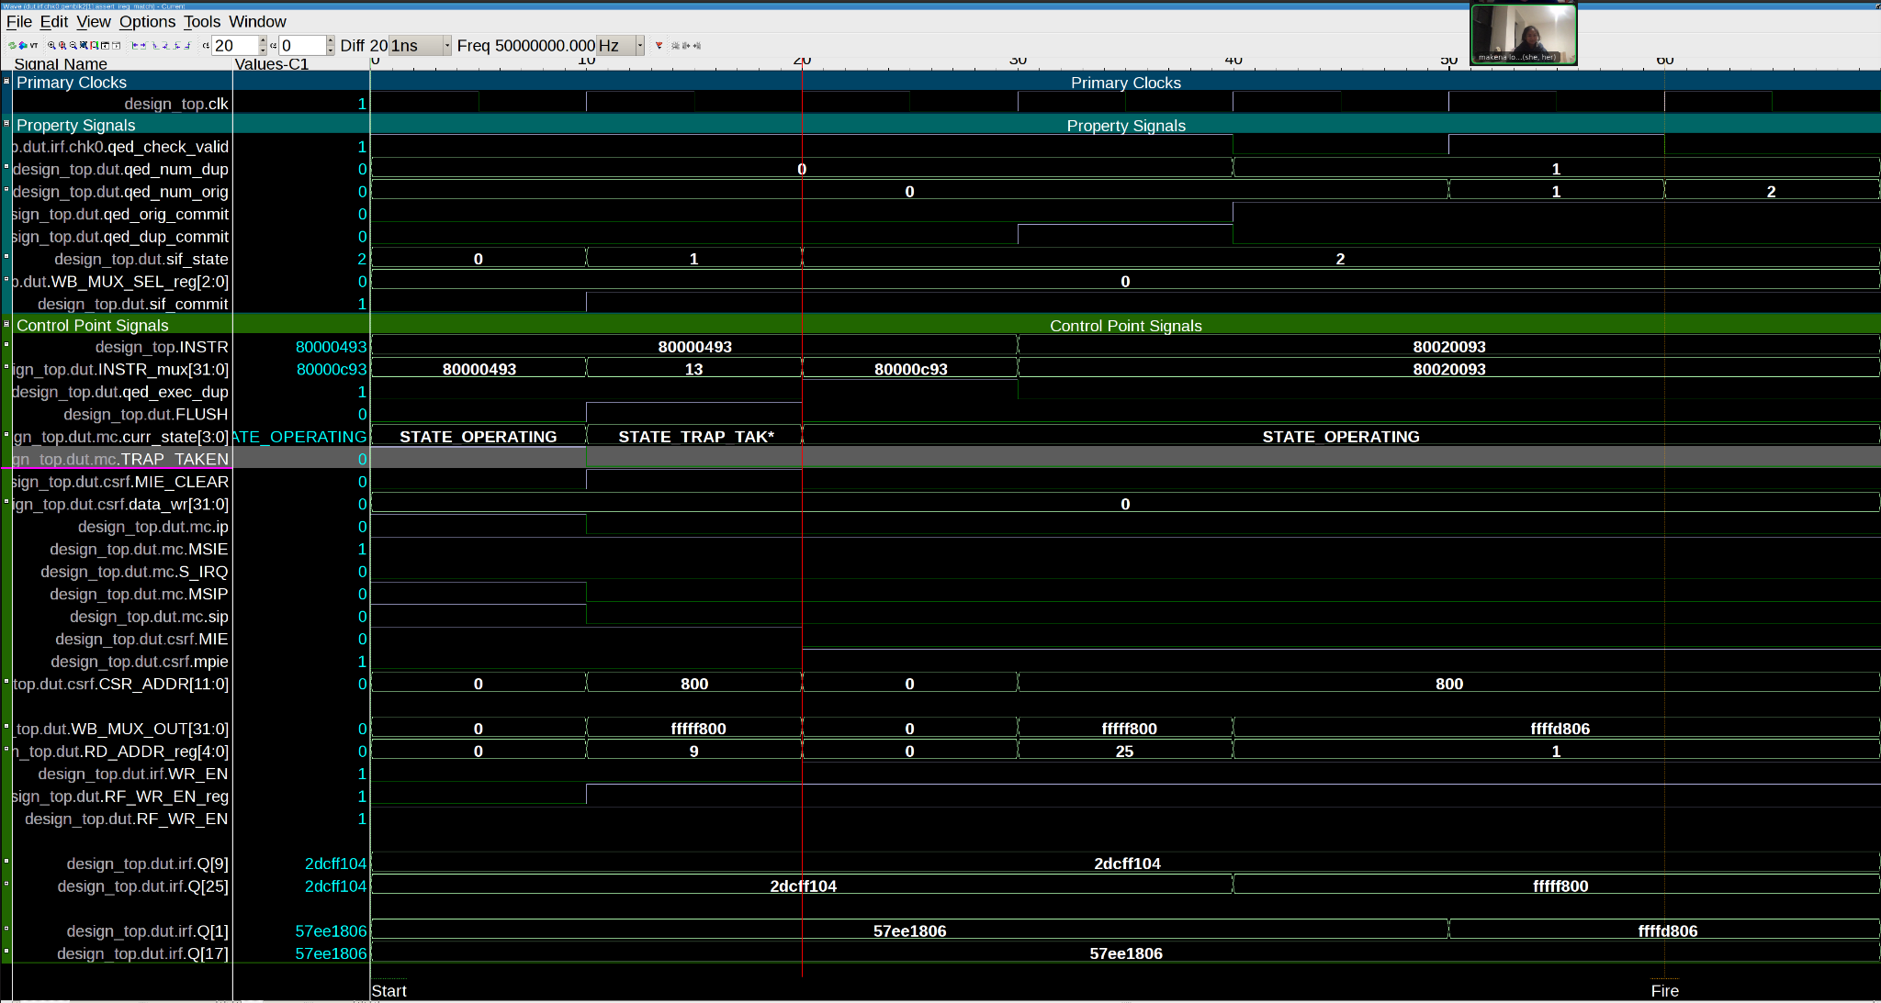

Slide 6
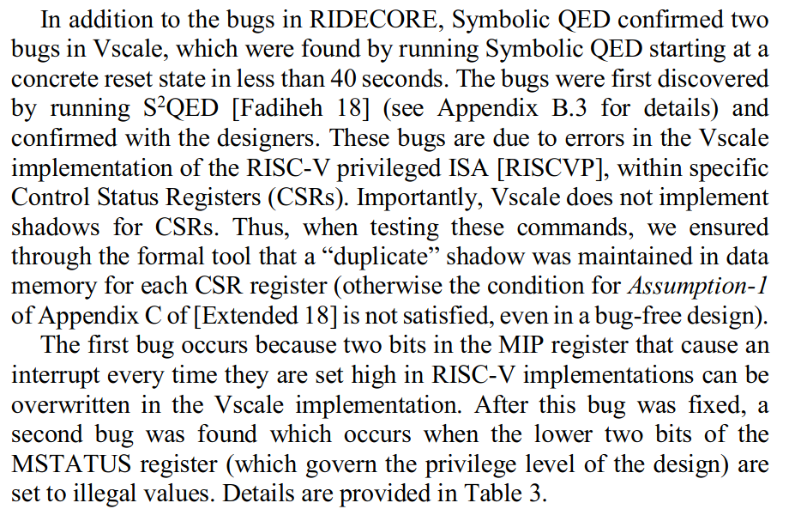
CSR in Previous Demo
How was this shadowing implemented without major re-design?

Slide 7
Steel Demo - Next Steps
Dealing with this specific issue:
Special constraint to push “commit time” of SIF Instructions when FLUSH occurs
Temporarily disabling CSR registers to look for other counterexamples
Duplicating the CSR file during verification?
General Question: How should we deal with non-partitionable elements?

Slide 8
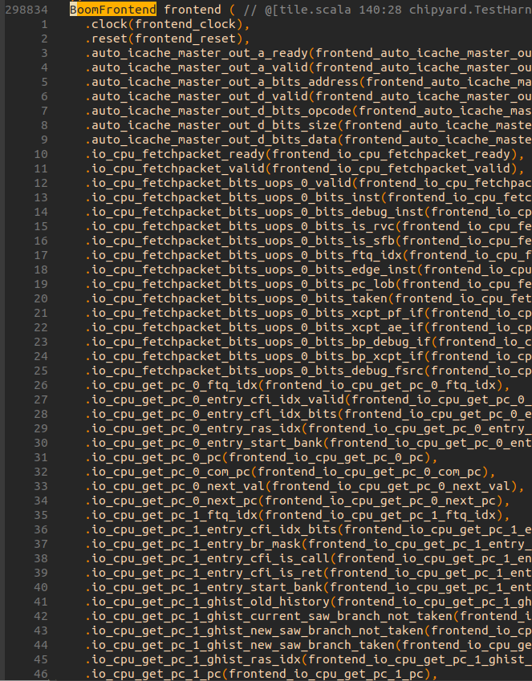
BOOM Demo - Current Status
Generated BOOM SoC Verilog
~ 300k LoC
Working on separating core vs SoC components
Chipyard does not generate core only

Slide 9
Next Steps Summary
Extend scope of ISA and finish Steel deployment
Deploying QED module to generated BOOM verilog

